Slide 1
Digital Portfolio
STUDENT NAME: Sheema Maryam M
REGISTER NO AND NMID: 31224U09084
DEPARTMENT: BCA
COLLEGE: COLLEGE/ UNIVERSITY Islamiah Womens Arts and Science College

Slide 2
PROJECT TITLE
“Design and Development of a Personal Portfolio Website”

Slide 3


AGENDA
Problem Statement
Project Overview
End Users
Tools and Technologies
Portfolio design and Layout
Features and Functionality
Results and Screenshots
Conclusion
Github Link
3/21/2024 Annual Review

Slide 4

PROBLEM STATEMENT
In today’s competitive digital era, every student and professional needs a personal brand identity. Recruiters and clients often evaluate candidates based on their online presence. Without a proper portfolio, it becomes challenging to showcase skills, projects, and creativity effectively.

Slide 5

PROJECT OVERVIEW
This project is a comprehensive portfolio design and development initiative aimed at showcasing personal or professional work. The primary goal is to create an aesthetically pleasing, easy-to-navigate, and fully functional digital space that highlights the creator’s skills, experiences, and accomplishments. The project includes: Visual and user interface design Responsive web development Integration of interactive features Deployment on the web

Slide 6

WHO ARE THE END USERS?
The portfolio targets the following end users: Potential employers or clients looking to assess your capabilities Collaborators interested in partnering on future projects Peers and industry professionals who want to connect or network General audience curious about your work The user experience is tailored to be intuitive and engaging, with quick access to key information such as projects, resume, and contact details

Slide 7

TOOLS AND TECHNIQUES
To build the portfolio, a combination of design and development tools and techniques were used: Design Tools:Figma / Adobe XD (for UI/UX wireframes and prototypes),Adobe Photoshop or Illustrator (for visual assets) Development Tools:HTML5, CSS3, JavaScript,React.js / Vue.js (if SPA or dynamic interactivity is used),Bootstrap or Tailwind CSS (for responsive design),Git & GitHub (version control and hosting),Netlify / Vercel / GitHub Pages (deployment) Techniques:Mobile-first responsive design,Accessibility best practices (WCAG compliance),SEO optimization,Code modularity and reusability

Slide 8
POTFOLIO DESIGN AND LAYOUT
The portfolio follows a clean, modern, and minimalistic layout for maximum usability: Core Layout Sections: 1. Homepage – Quick introduction and navigation 2. About – Background, education, and skills 3. Projects – Case studies or thumbnails with links to detailed views 4. Resume – Downloadable or viewable resume/CV 5. Contact – Contact form and/or social media links Design Principles: Consistent color palette and typography Clear visual hierarchy Interactive elements with subtle animations Use of whitespace to enhance readability
8

Slide 9
FEATURES AND FUNCTIONALITY
The portfolio includes a variety of interactive and technical features: Responsive layout for mobile, tablet, and desktop Smooth scrolling and transitions Dark mode toggle Live project links and GitHub repos Contact form with validation and integration (e.g., Formspree or EmailJS) Search or filter functionality for projects (optional) Blog or article section (optional)

Slide 10
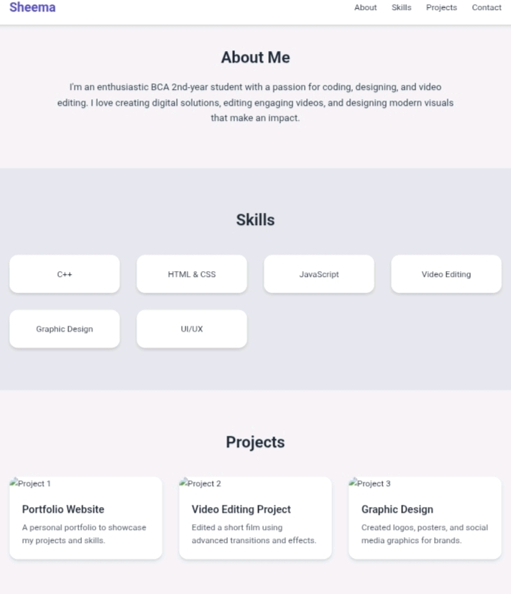

RESULTS AND SCREENSHOTS
3/21/2024 Annual Review
10

Slide 11
CONCLUSION
The completed portfolio successfully represents the creator’s skills, personality, and professional value in a dynamic and visually engaging format. It serves as both a personal brand and a practical tool for career advancement, providing visitors with an intuitive and informative experience. The project demonstrates strong competencies in design thinking, front-end development, and user-centered design — making it a key asset in the creator’s digital presence.
11

